Slide 1
Image Preprocessing and the Convolution Neural Network Model for Traffic Light Recognition

Slide 2
1.
INTRO
What is a Convolutional Neural Network?

Slide 3
Convolutional Neural Network
Used in machine learning, specifically images to build models that can label data
Comprised of layers of “neurons” that take information from the previous layer and change it by giving it a weight and bias
Will input an image and output a matrix of probabilities - size is number of labels
For my project, since there are 3 labels (green, red, yellow), the output is three numbers
The highest number’s location is the prediction result

Slide 4
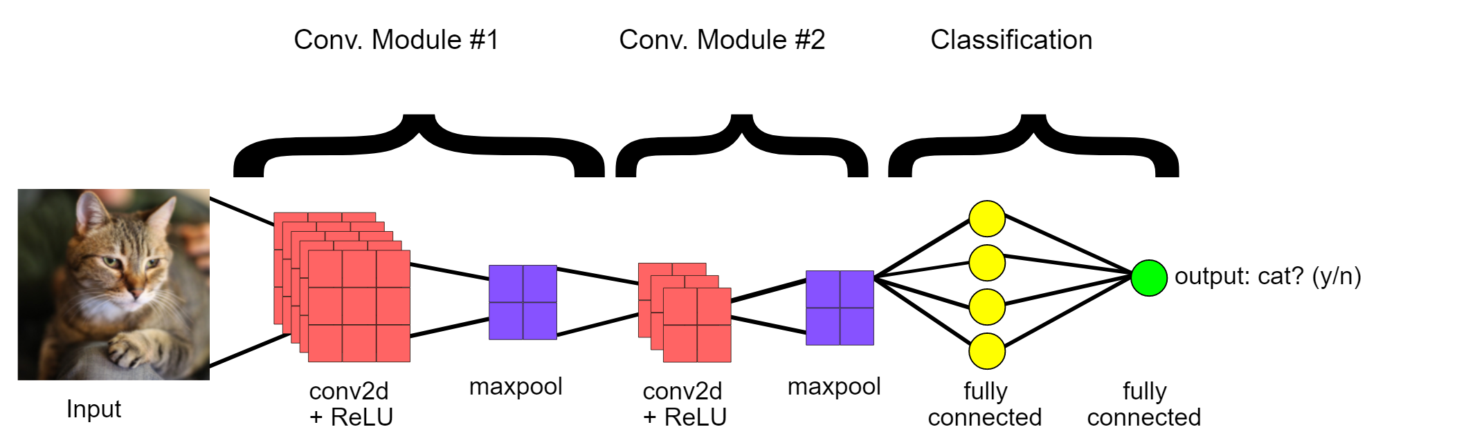

Slide 5
2.
MY PROJECT
Traffic Light Recognition

Slide 6
My Project
Goal: classify an image of a traffic light as red, green, or yellow
Using the online Bosch dataset as training data, I created a CNN from the already annotated images
For my project, since there are 3 labels (green, red, yellow), the output is three numbers, and we choose the largest one to determine which label the network predicts

Slide 7
Bosch Dataset
Public dataset of annotated traffic lights, can be found here
The Bosch dataset has both test and training
I swapped them because training data had errors in labeling
Training (test file on website): 8334 images
Test (training file on website): 5093 images
Resolution of 1280 x 720 pixels

Slide 8
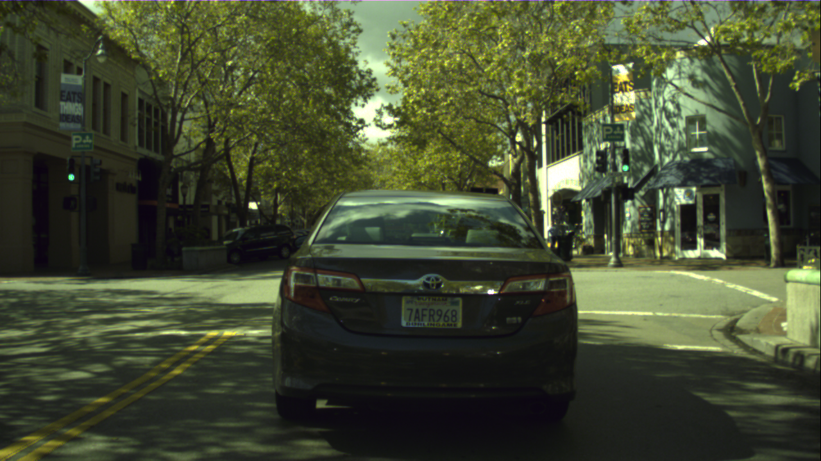
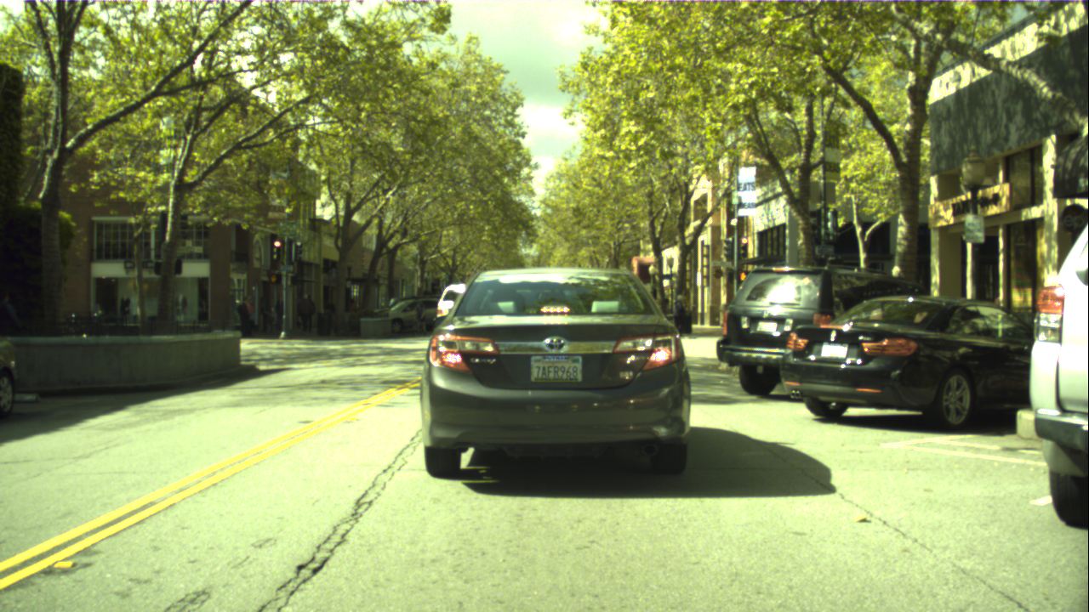
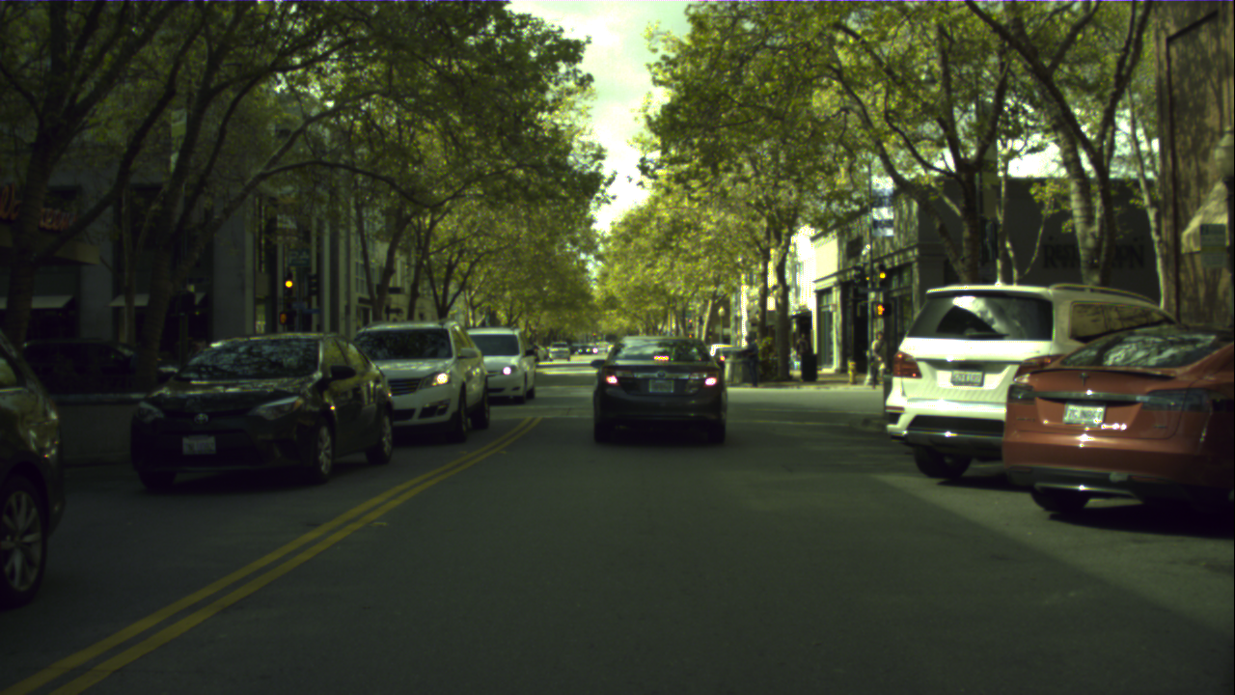
EXAMPLE ORIGINAL TRAINING IMAGES

Slide 9
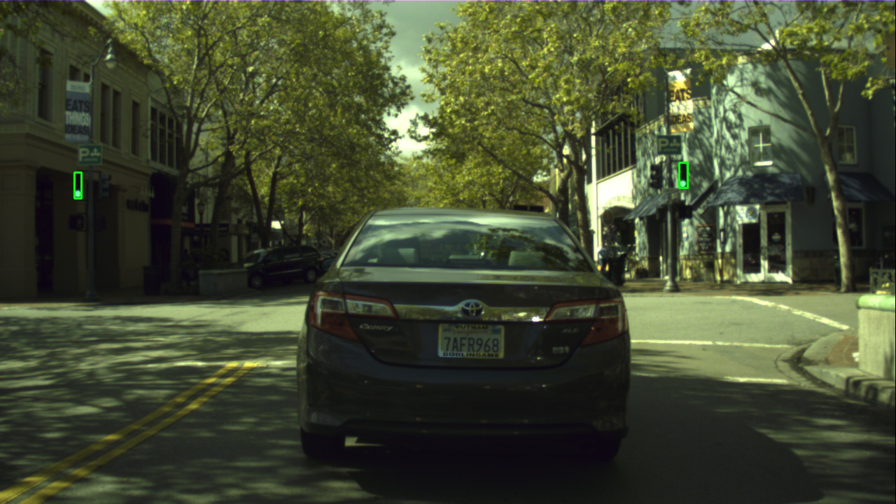
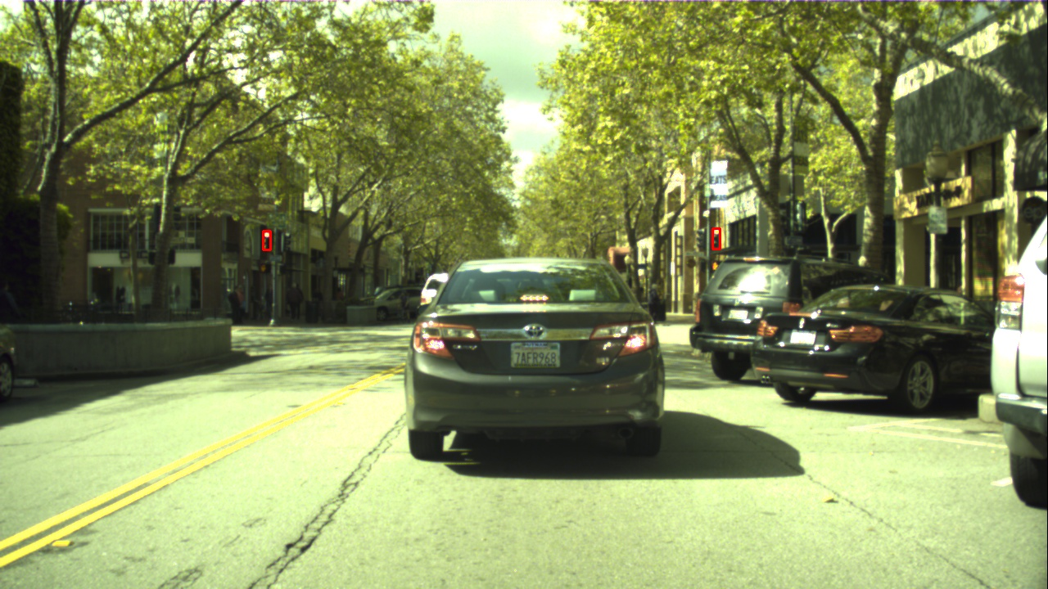
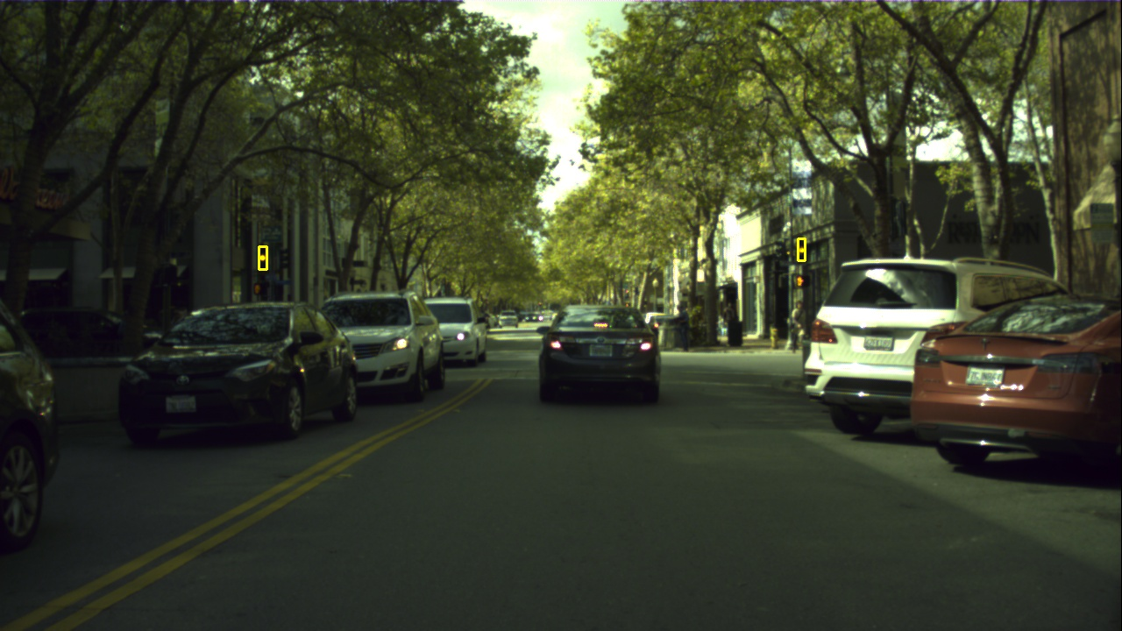
EXAMPLE ANNOTATED TRAINING IMAGES

Slide 10
3.
EXECUTION
Steps to creating the CNN

Slide 11
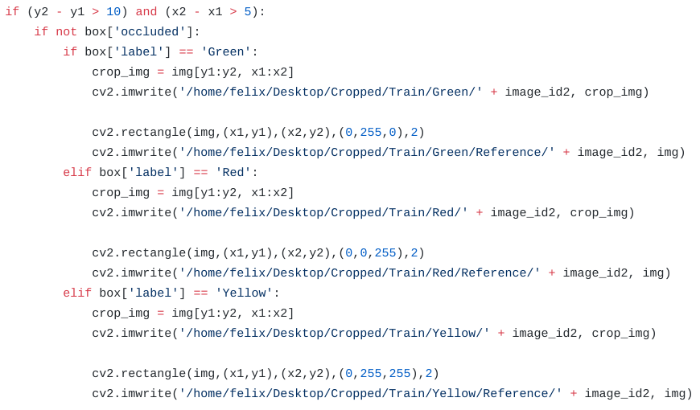
Preprocessing
To use the training images, I first cropped out the individual traffic lights and separated them into folders based on their label
Used YAML file
Originally had off + occluded as labels, I removed
Only used traffic lights that were more than 10 pixels tall and 5 pixels wide
Saved the annotated images + cropped images
Split the training data into 80% to true training, 20% to validation (check for overfitting)

Slide 12
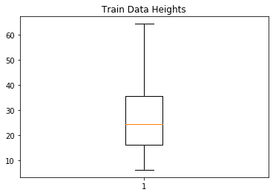
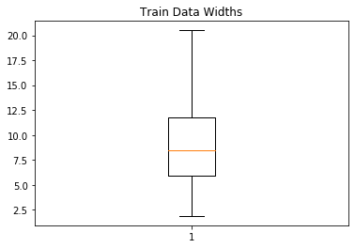
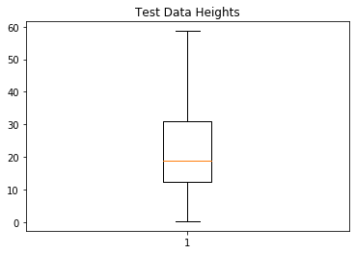
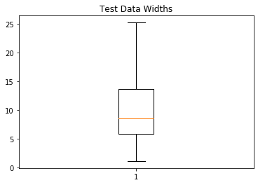
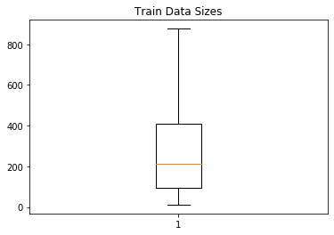
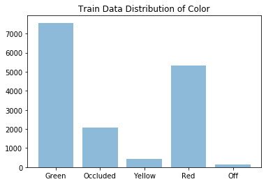
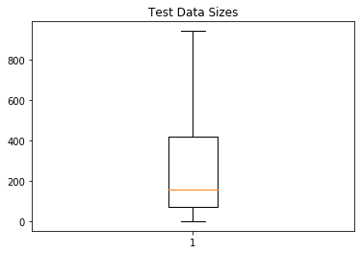
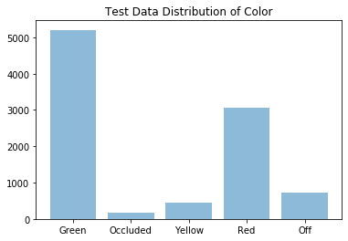
TRAIN AND TEST DATA STATISTICS
Train
Test

Slide 13
EXAMPLE CROPPED TRAINING IMAGES

Slide 14
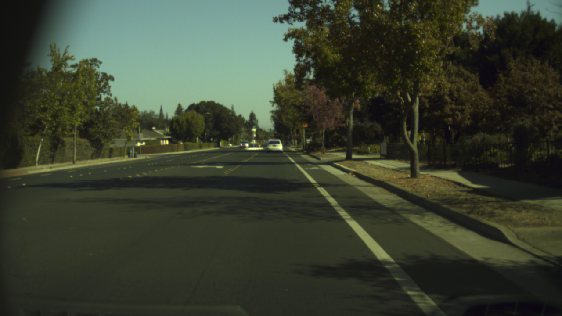
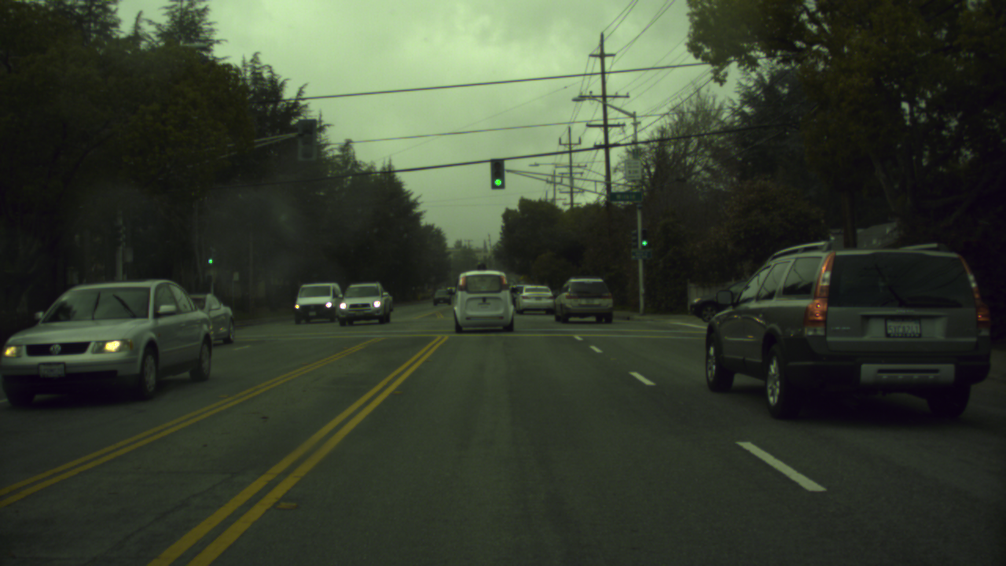
Challenging Cases
Too small
Occluded

Slide 15
Training
Based on calculating cross entropy loss aka softmax loss, where the loss is -log of the sum of the other label probabilities
The more accurate the labeling, the lower the loss
Initialized learning rate at 0.001, decay learning rate by ⅕ when change in loss is less than 5 times the learning rate
Went through 10 epochs (repetitions) through all the data
Used architecture from a CIFAR-10 tutorial
After saving the data and running through the training, test, and validation data...

Slide 16
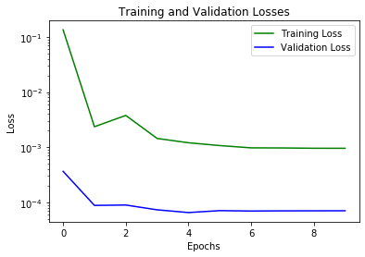
Training and Validation Losses

Slide 17
a
6 5x5 Filters
16 5x5 Filters
b
Max Pooling
Max Pooling
FC 400
FC 120
FC 84
c
Starting Image
End Probabilities

Slide 18
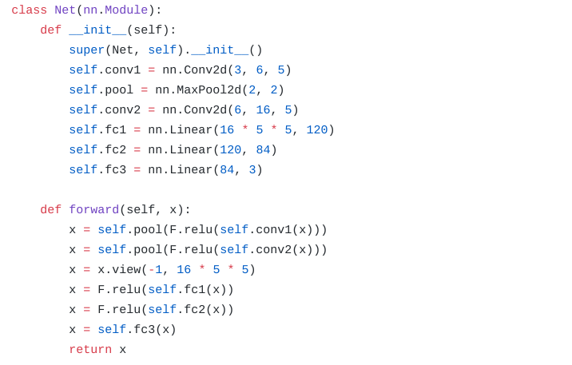
THE CNN
Place your screenshot here

Slide 19
4.
RESULTS
How did my model do?

Slide 20
99% (4897/4898)
100% (1225/1225)
91% (2705/2941)
Training
Validation
Test

Slide 21
Inside the Test Results
97% (1682/1730)
92% (964/1042)
34% (59/169)
Green
Red
Yellow

Slide 22
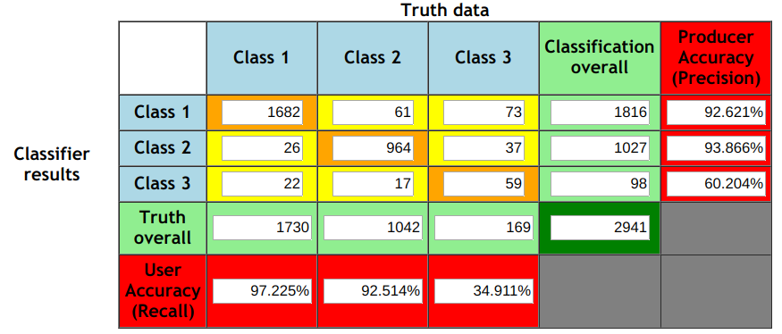
Results and Analysis
As expected, green was the most accurate, then red, then yellow
Most likely due to lack of training data for yellow
Many yellow’s were classified as green
Confusion Matrix:
Class 1 = Green, Class 2 = Red, Class 3 = Yellow

Slide 23
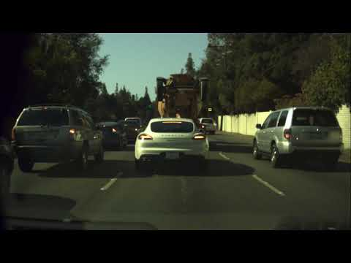
Demo Video

Slide 24
Future Expansions
Use data augmentation to make training data categories roughly even
Incorporate arrows (all colors, left, straight, and right)
Include image detection, find traffic lights without bounding boxes from YAML
Create hardware, attach to dashcam, predict in real time
Use on self-driving cars!

Slide 25
THANK YOU!
You can find me at
jerryxu4@gmail.com
Github: https://github.com/xu-jerry/trafficlight-project

